Slide 1
OPER 623 – Heuristic Search Methods
Lesson 10
Simulated Annealing (SA)

Slide 2
Overview
Local Minima
Neighbor Selection
Simulated Annealing
Iterative Local Search
Metropolis Heuristic
Simulated Annealing

Slide 3
Overview
Local Minima
Neighbor Selection
Simulated Annealing
Iterative Local Search
Metropolis Heuristic
Simulated Annealing

Slide 4
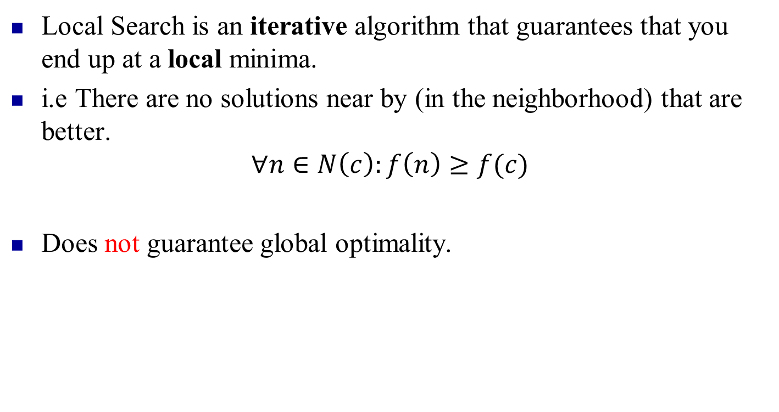
Local Search Review
Local Search is an iterative algorithm that guarantees that you end up at a local minima.
i.e There are no solutions near by (in the neighborhood) that are better.
$$∀n∈N\left(c\right):f\left(n\right)≥f(c)$$
Does not guarantee global optimality.
Escaping local optima is a critical issue in heuristic search.

Slide 5

Escaping Local Minima
Let darker yellow be “Better”

Slide 6
Escaping Local Minima
Let darker yellow be “Better”

Slide 7
Escaping Local Minima
Let darker yellow be “Better”
Local Search when local optima is also global optima is easy

Slide 8
Escaping Local Minima
Let darker yellow be “Better”
Local Search when local optima is also global is easy

Slide 9
Escaping Local Minima
Let darker yellow be “Better”
Local Search when local optima is also global is easy

Slide 10

Escaping Local Minima
Let darker yellow be “Better”
Local Search when local optima is also global is easy

Slide 11

Escaping Local Minima
Let darker yellow be “Better”

Slide 12
Escaping Local Minima
Let darker yellow be “Better”
Local Search with lots of local Optima is not so easy!

Slide 13
Escaping Local Minima
Let darker yellow be “Better”
Local Search with lots of local Optima is not so easy!

Slide 14
Escaping Local Minima
Let darker yellow be “Better”
Local Search with lots of local Optima is not so easy!

Slide 15

Escaping Local Minima
Let darker yellow be “Better”
Local Search with lots of local Optima is not so easy!

Slide 16
Escaping Local Minima
Let darker yellow be “Better”
Different starting conditions = different local optima

Slide 17
Escaping Local Minima
Let darker yellow be “Better”
Different starting conditions = different local optima

Slide 18
Escaping Local Minima
Let darker yellow be “Better”
Different starting conditions = different local optima

Slide 19
Escaping Local Minima
Let darker yellow be “Better”
Different starting conditions = different local optima

Slide 20
Escaping Local Minima
Let darker yellow be “Better”
GRASP?
Could just keep trying lots of starting locations… and hope for the best

Slide 21
Escaping Local Minima
Let darker yellow be “Better”
GRASP?
Could just keep trying lots of starting locations… and hope for the best

Slide 22
Escaping Local Minima
Let darker yellow be “Better”
Could just keep trying lots of starting locations… and hope for the best

Slide 23
Escaping Local Minima
Let darker yellow be “Better”
GRASP?
Could just keep trying lots of starting locations… and hope for the best

Slide 24

Escaping Local Minima
Let darker yellow be “Better”
GRASP?
Could just keep trying lots of starting locations… and hope for the best

Slide 25
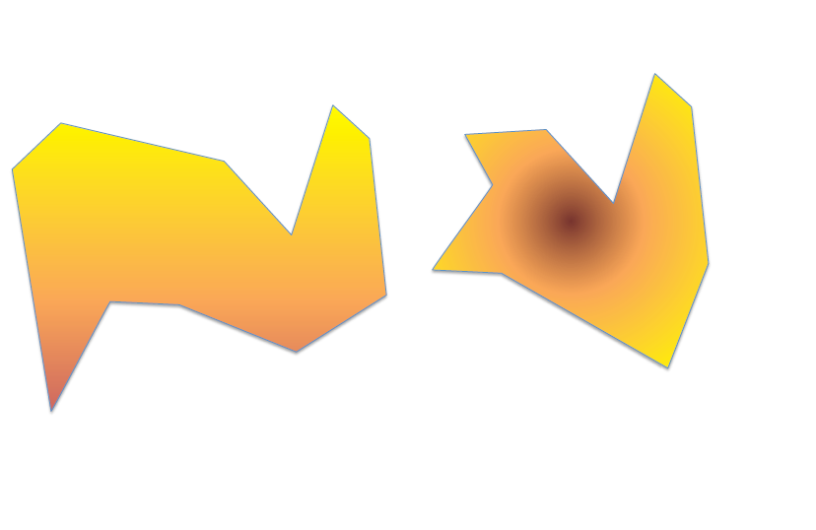
Escaping Local Minima
Let darker yellow be “Better”
Better hope your choice of move/neighborhoods ensures solution set is connected!

Slide 26
Escaping Local Minima
Let darker yellow be “Better”
Better hope your choice of move/neighborhoods ensures solution set is connected!

Slide 27
Escaping Local Minima
Let darker yellow be “Better”
Better hope your choice of move/neighborhoods ensures solution set is connected!

Slide 28
Escaping Local Minima
Let darker yellow be “Better”
Better hope your choice of move/neighborhoods ensures solution set is connected!

Slide 29

Escaping Local Minima
Let darker yellow be “Better”
Better hope your choice of move/neighborhoods ensures solution set is connected!

Slide 30
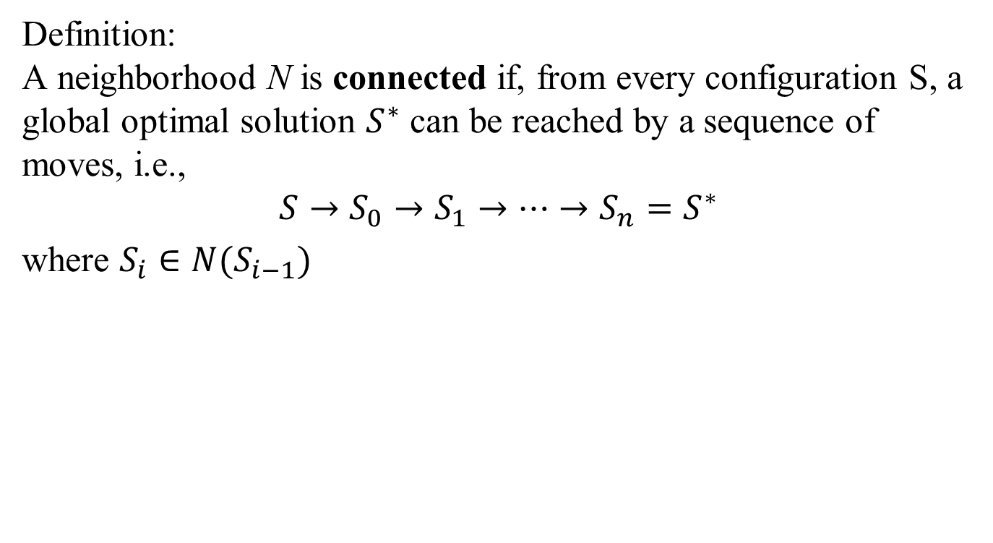
Connected Neighborhood
Definition: A neighborhood N is connected if, from every configuration S, a global optimal solution $S^{∗}$ can be reached by a sequence of moves, i.e.,
$$S→S_{0}→S_{1}→…→S_{n}=S^{∗}$$
where $S_{i}∈N(S_{i−1})$
Note that connectivity does NOT imply your heuristic will get to the global optima. Usually, evaluation (which move to make) rules will prevent you from making some of the necessary moves.

Slide 31
Neighborhood Connectivity
How do you show that your neighborhood is connected?
Sometimes starting at the end is a very good place to start.
Step 1:
Assume you know the optimal solution to your problem, S* and that you have some starting configuration S.
Step 2: Work backwards from S* to see if you can get to S.
Proof by Induction.

Slide 32
Neighborhood Connectivity
Graph coloring
Consider the move where you just switch the color of a particular node.
Want to prove neighborhood is connected
Input: Current configuration S
Input: Optimal configuration S*
for each node n do
if S_{n} not equal to S_{n}* then
S_{n} := S_{n}*
end if
end for
Look at each node.
If nodes color does not match the optimal color.
Switch it so it matches the optimal color.

Slide 33
Overview
Local Minima
Neighbor Selection
Simulated Annealing
Iterative Local Search
Metropolis Heuristic
Simulated Annealing

Slide 34
Local Search Review
States: either solutions or configurations
Move from state s to one of its neighbors in N(s)
Some neighbors are legal; others are not
Let L(N(s), s) be the set of legal* neighbors.
Select one of the legal neighbors dictated by the heuristic’s methodology
*What makes a neighbor legal?
Typically, the evaluation criteria for the heuristic.

Slide 35
Neighborhood Selection

Slide 36
Neighborhood Selection
Start at a random solution

Slide 37
Neighborhood Selection
Not all neighbors will be legal neighbors

Slide 38
Neighborhood Selection
Move to a legal neighbor

Slide 39
Neighborhood Selection
Re-evaluate set of legal neighbors

Slide 40
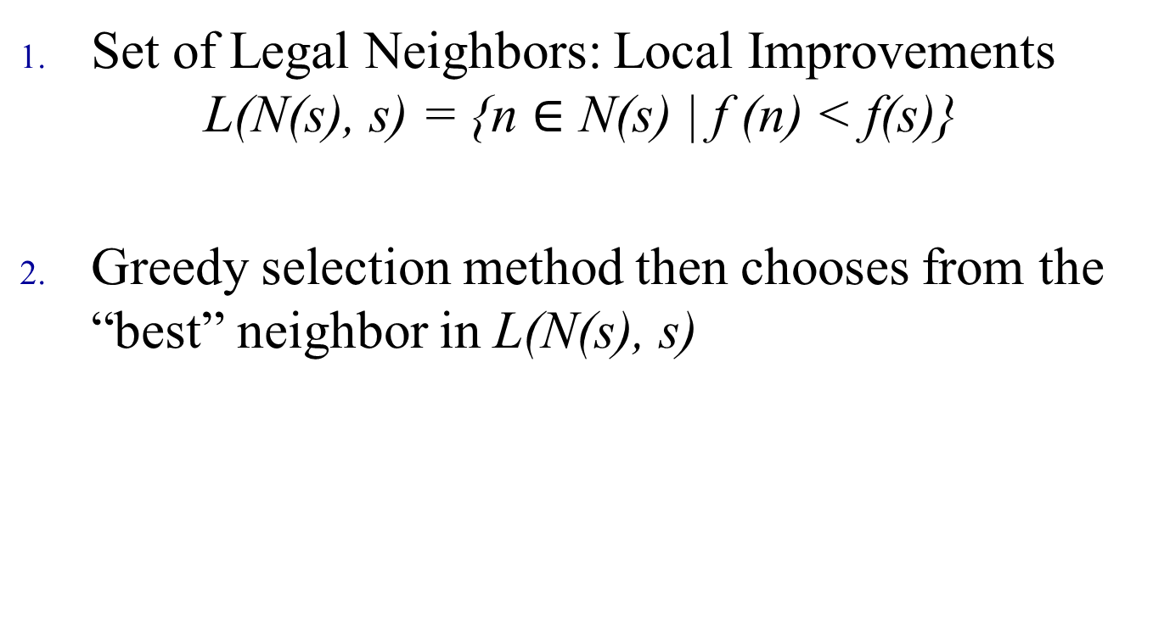
An Example of Local Search
Set of Legal Neighbors: Local Improvements $\text{L}\text{(}\text{N}\text{(}\text{s}\text{)}\text{,} \text{s}\text{) = }\text{\{}\text{n}∈\text{N}\text{(}\text{s}\text{)}\text{ | }\text{f}\text{ (}\text{n}\text{) < }\text{f}\text{(}\text{s}\text{)}\text{\}}$
Greedy selection method then chooses from the “best” neighbor in $\text{L}\text{(}\text{N}\text{(}\text{s}\text{)}\text{,} \text{s}\text{) }$

Slide 41
Heuristic vs Metaheuristic
Heuristic
Choose the next neighbor
Use local information
Minimal memory (limited usually to best solution visited)
Drive the search towards a local minimum
Metaheuristics
Aim at escaping local minima
Drive the search towards a global minimum
Typically include some memory or learning aspect

Slide 42
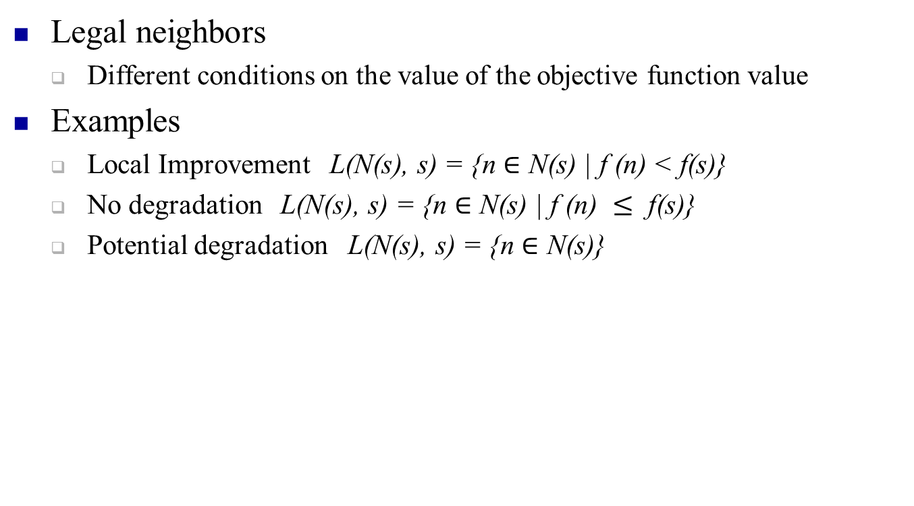
Heuristics 1. Define set of Legal Neighbors
Legal neighbors
Different conditions on the value of the objective function value
Examples
Local Improvement $\text{L}\text{(}\text{N}\text{(}\text{s}\text{)}\text{,} \text{s}\text{) = }\text{\{}\text{n}∈\text{N}\text{(}\text{s}\text{)}\text{ | }\text{f}\text{ (}\text{n}\text{) < }\text{f}\text{(}\text{s}\text{)}\text{\}}$
No degradation $\text{L}\text{(}\text{N}\text{(}\text{s}\text{)}\text{,} \text{s}\text{) = }\text{\{}\text{n}∈\text{N}\text{(}\text{s}\text{)}\text{ | }\text{f}\text{ (}\text{n}\text{) }≤ \text{f}\text{(}\text{s}\text{)}\text{\}}$
Potential degradation $\text{L}\text{(}\text{N}\text{(}\text{s}\text{)}\text{,} \text{s}\text{) = }\text{\{}\text{n}∈\text{N}\text{(}\text{s}\text{)}\text{\}}$

Slide 43
Heuristics 2. Neighbor Selection
How to select the neighbor?
Exploring the whole or part of the neighborhood
Best neighbor
Select the best neighbor in the neighborhood
First neighbor
Select the first legal neighbor in the neighborhood
Multi-stage selection
Select one aspect of neighbor
Select remaining aspects of the neighbor

Slide 44
Multi-stage Selection
Vital to avoid scanning the entire neighborhood
Still keep a greedy flavor
Max then Min Conflict
First part: Greedy, Select the column with the queen who has the most violations.
Second part: Greedy, Move the queen to the row that will reduce the violations the most.
Random then Min Conflict
First part: Random, Select the column of a queen at random.
Second part: Greedy, Move the queen to the row that will reduce the violations the most.

Slide 45
Randomization in Local Search
How can you use randomization in local search?
Deciding whether a neighbor is legal.
Roll the dice to decide if that neighbor is legal
Deciding which neighbor to move to or select.
Roll the dice to see if you should move
Where can you see that randomization is beneficial?
Very large and complex neighborhoods.
Too time consuming to scan for all neighbors (TSP)
Randomness allows you to break out of local minima

Slide 46
Overview
Local Minima
Neighbor Selection
Simulated Annealing
Iterative Local Search
Metropolis Heuristic
Simulated Annealing

Slide 47
Iterative Local Search
We saw this with GRASP
Iterative Local Search is performing the same local search routine with a different starting point.
Can be combined with many metaheuristics

Slide 48
Overview
Local Minima
Neighbor Selection
Simulated Annealing
Iterative Local Search
Metropolis Heuristic
Simulated Annealing

Slide 49
Metropolis Heuristic
Metropolis Monte Carlo simulation
Developed in 1953 by Nicholas Metropolis et al
Observed that to get to a global optimum, you sometimes have to make “bad” moves
Basic idea:
Accept a move if it improves the objective function value
If a move does not improve the objective function value, accept it anyway with some probability
The probability depends on how `bad' the solution is
Originally based on physics

Slide 50
Metropolis Heuristic
Choose moves randomly. If good accept, if bad MAYBE accept anyway
Move Considered.
Move Accepted.
Let darker yellow be “Better”

Slide 51
Metropolis Heuristic
Move Considered.
Move Accepted.
Let darker yellow be “Better”

Slide 52
Metropolis Heuristic
Some “Bad” moves will be randomly rejected
Move Considered.
Move Rejected.
Let darker yellow be “Better”

Slide 53
Metropolis Heuristic
Move Considered.
Move Accepted.
Let darker yellow be “Better”

Slide 54
Metropolis Heuristic
Move Considered.
Move Accepted.
Let darker yellow be “Better”

Slide 55
Metropolis Heuristic
Some “bad” moves will be randomly accepted
These “bad” moves allows us the possibility to “break out” of local minima
Move Considered.
Move Accepted.
Let darker yellow be “Better”

Slide 56
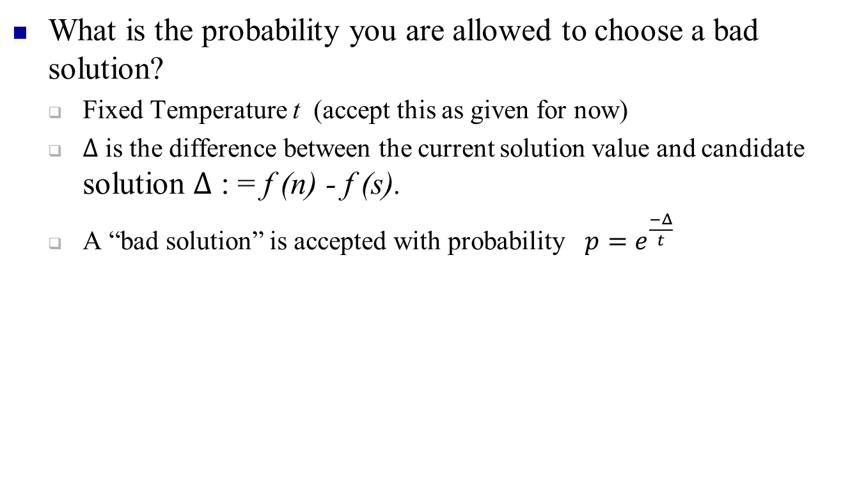
Metropolis Heuristic: Probability
What is the probability you are allowed to choose a bad solution?
Fixed Temperature t (accept this as given for now)
$Δ$ is the difference between the current solution value and candidate solution $Δ$ : = f (n) - f (s).
A “bad solution” is accepted with probability $p=e^{\frac{−Δ}{t}}$

Slide 57
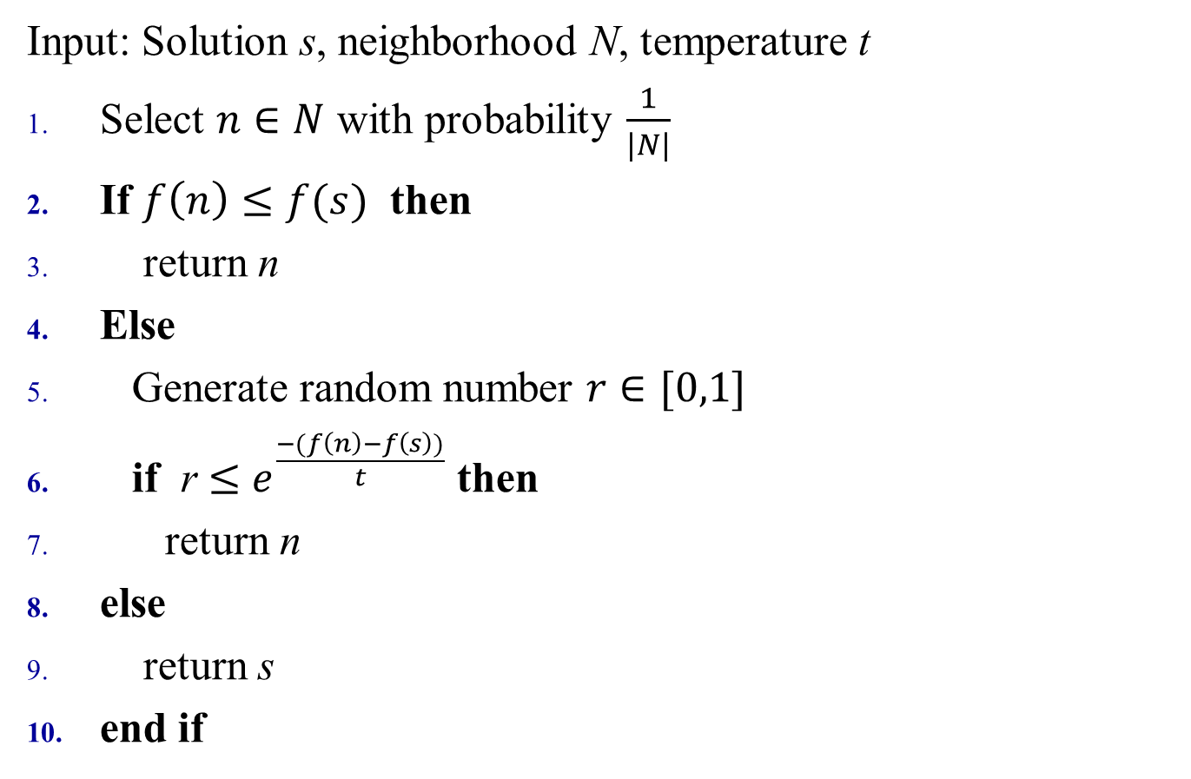
Metropolis Heuristic - Pseudocode
Input: Solution s, neighborhood N, temperature t
Select $n∈N$ with probability $\frac{1}{|N|}$
If $f\left(n\right)≤f(s)$ then
return n
Else
Generate random number $r∈[0,1]$
if r $≤$ $e^{\frac{−(f\left(n\right)−f\left(s\right))}{t}}$ then
return n
else
return s
end if

Slide 58
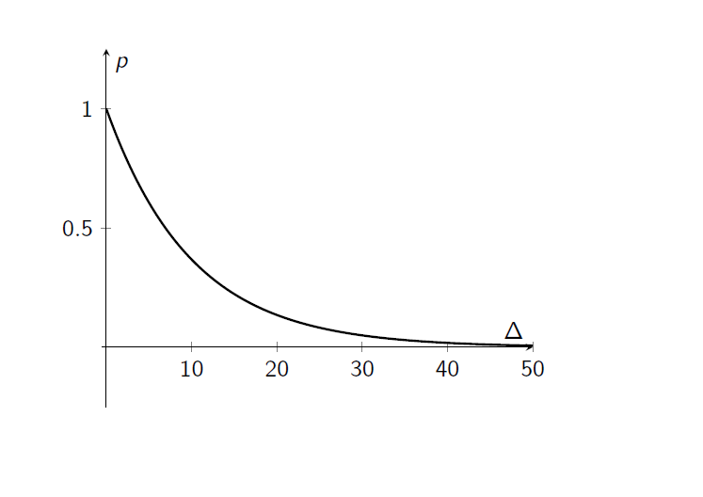

Acceptance probability: t = 10
Recall that $Δ=\left(f\left(n\right)−f\left(s\right)\right)$

Slide 59
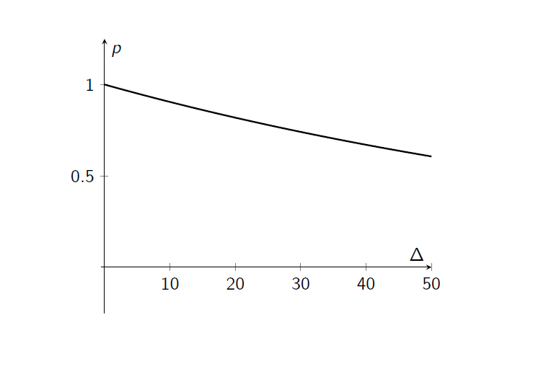
Acceptance probability: t = 100

Slide 60
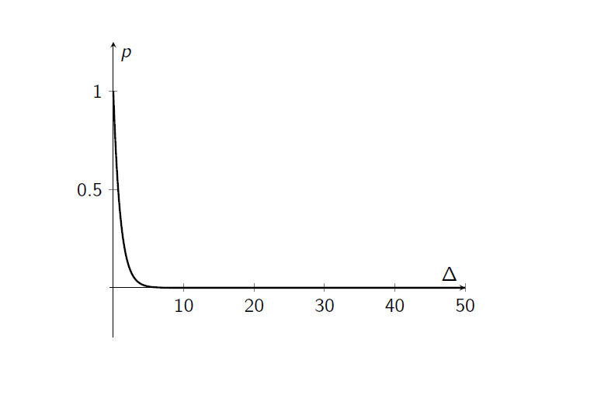
Acceptance probability: t = 1

Slide 61
Overview
Local Minima
Neighbor Selection
Simulated Annealing
Iterative Local Search
Metropolis Heuristic
Simulated Annealing

Slide 62
Annealing
https://www.youtube.com/watch?v=tN5jf88_cp0

Slide 63
Simulated Annealing (SA)
Just Metropolis's heuristic with a function for temperature
Function slowly cools the temperature with hopes to find the global optimal
When the temperature is hot, more exploration can occur.
Diversification
As the temperature cools, less exploration occurs with hopes to dive down to the local (ideally global) optimum.
Intensification

Slide 64
Customizations for SA
How to get an initial solution?
Starting temperature?
How many iterations to perform at each temperature?
How to cool the temperature?
Overall stopping criteria?
Neighborhood definition?
Constraint violations allowed?
Alternate probability functions for acceptance?

Slide 65
Initial Temperature
How high is high?
Too high becomes random search
May find good solutions but thermal equilibrium not reached
Too low search may become trapped prematurely
Based temp on initial acceptance ratio
Good range is [0.9-0.99]
Want a good sample of initial neighborhood

Slide 66
SA Temperature Control
Perhaps the most critical decisions for SA!!!
Comprised of two questions
How long to search at each temp
How to reduce temp after each search

Slide 67
SA Temperature Control
How long to search at each temp
Theory suggest long enough to reach equilibrium at each temp
Fixed number of iterations
Based on problem or neighborhood size
Based on number of accepted moves or attempted moves
Variable number of iterations
Based on change in “rolling” average (approx. equilibrium)
Based on number of iterations without improving best

Slide 68
SA Temperature Control
How to reduce temp after each search
What type of function?
Two most common
Linear (i.e. t = t - ∆t )
Smaller values of ∆t usually work best
Geometric (i.e. t = αt )
α near 1 is slow cooling; α near 0 is fast cooling
Higher values of α usually work best [0.8-0.99]
What is the final temp
Theory suggest t → 0

Slide 69
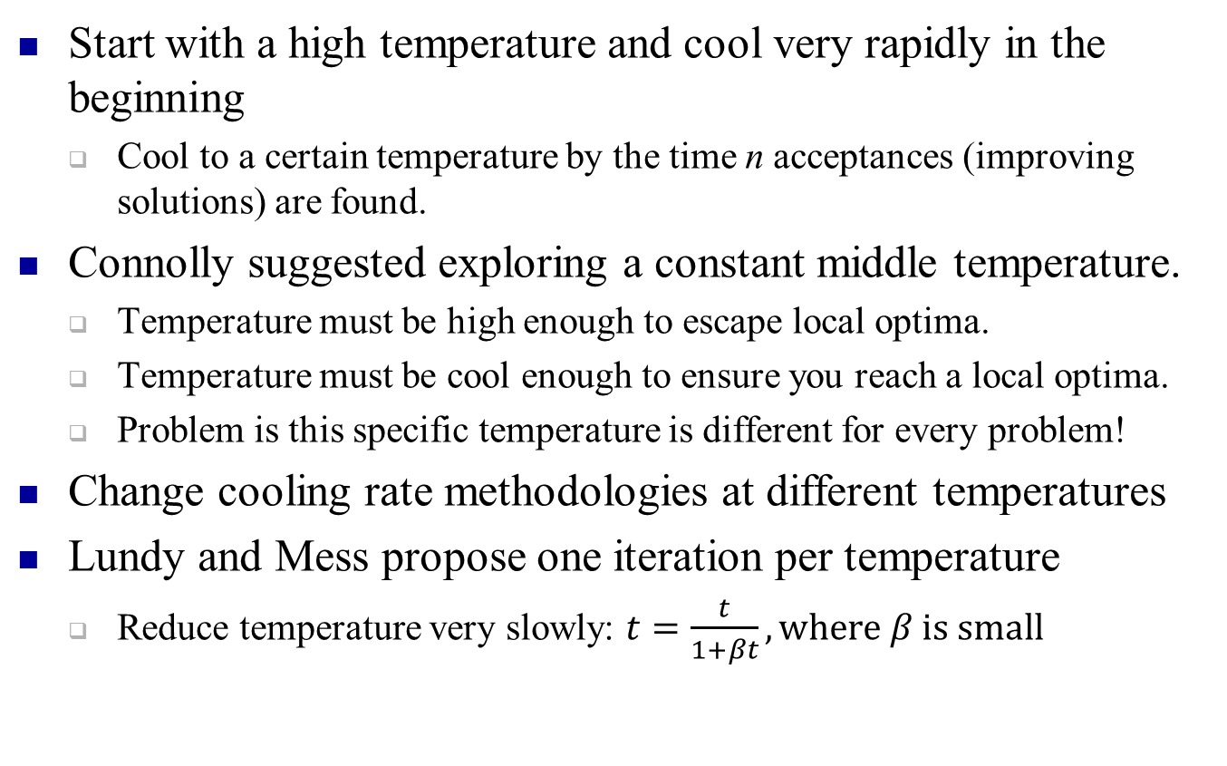
SA Temperature Control General Thoughts
Start with a high temperature and cool very rapidly in the beginning
Cool to a certain temperature by the time n acceptances (improving solutions) are found.
Connolly suggested exploring a constant middle temperature.
Temperature must be high enough to escape local optima.
Temperature must be cool enough to ensure you reach a local optima.
Problem is this specific temperature is different for every problem!
Change cooling rate methodologies at different temperatures
Lundy and Mess propose one iteration per temperature
Reduce temperature very slowly: $t=\frac{t}{1+βt}, where β is small$

Slide 70
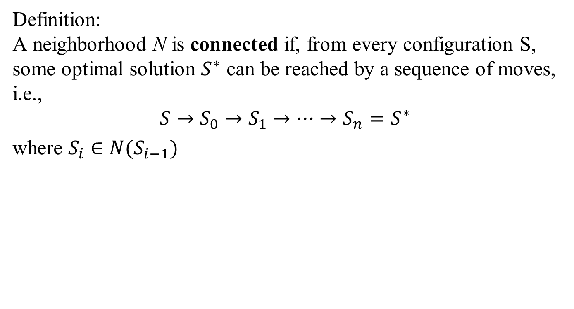
Reheating
Used for TSP, where the temperature is increased when it is apparent that the process got stuck in a configuration with suboptimal features.
Can also reheat when you observe certain changes in the objective function value, or solution.
Change the temperature based on the number of acceptances and rejections observed.
Acceptance $→$ cool based on $\frac{t}{(1+βt)}$
Rejection $→$ reheat based on $\frac{t}{(1+γt)}$
If $β=k γ$ then we would need k reheats to balance one cooling.

Slide 71
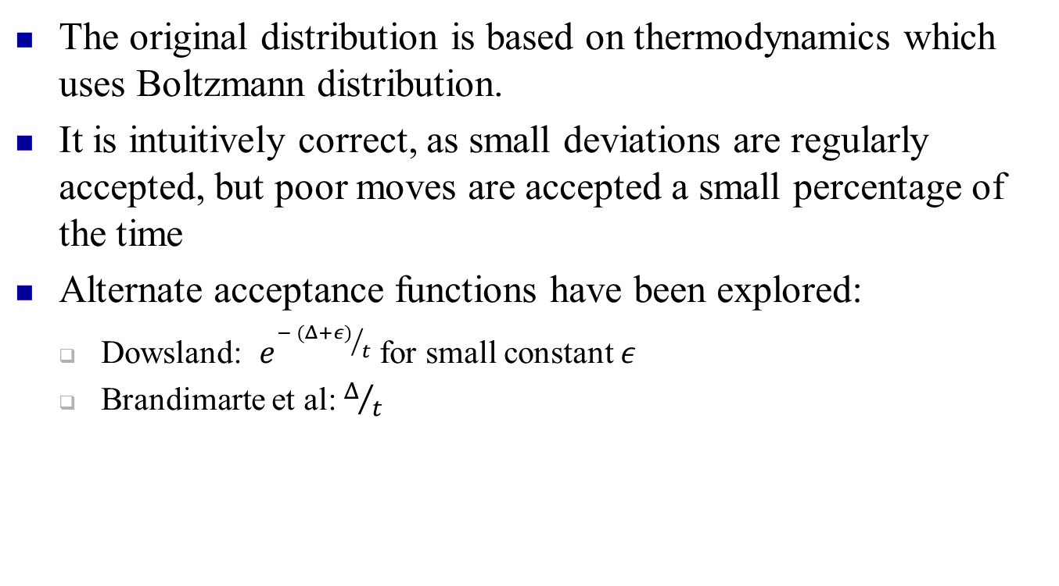
Acceptance Probability
The original distribution is based on thermodynamics which uses Boltzmann distribution.
It is intuitively correct, as small deviations are regularly accepted, but poor moves are accepted a small percentage of the time
Alternate acceptance functions have been explored:
Dowsland: $e^{{− (Δ+ε)}/t}$ for small constant $ε$
Brandimarte et al: $Δ/t$

Slide 72
Neighborhoods
Does neighborhood size even matter?
YES!
Smaller neighborhoods are faster but more likely to get trapped in local minima
Fixed definition for all of SA, or change as you go
Larger neighborhoods are explored at the beginning and then decreases as the temperature decreases?
3OPT then 2OPT?
Ensure connectivity

Slide 73
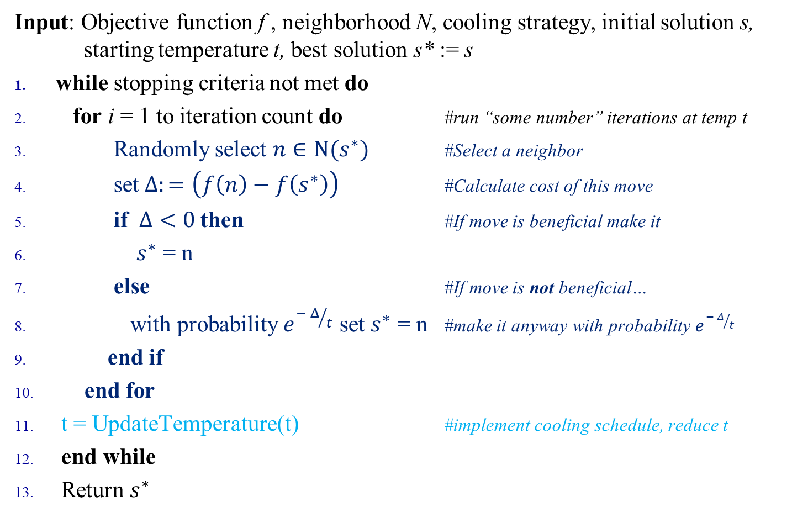
Simulated Annealing - Pseudocode
Input: Objective function f , neighborhood N, cooling strategy, initial solution s, starting temperature t, best solution s* := s
while stopping criteria not met do
for i = 1 to iteration count do #run “some number” iterations at temp t
Randomly select $n∈N(s^{∗})$ #Select a neighbor
set $Δ:=\left(f\left(n\right)−f\left(s^{∗}\right)\right)$ #Calculate cost of this move
if $Δ<0$then #If move is beneficial make it
$s^{∗}$ = n
else #If move is not beneficial…
with probability $e^{{− Δ}/t}$ set $s^{∗}$ = n #make it anyway with probability $e^{{− Δ}/t}$
end if
end for
t = UpdateTemperature(t) #implement cooling schedule, reduce t
end while
Return $s^{∗}$

Slide 74
SA vs Metropolis
Metropolis's Heuristic is lines 3 to 9, which is iteratively run for a set temperature.
The temperature is then updated (probably cooled) in line 11.
The number of iterations performed at each temperature (line 2) does not have to be constant.

Slide 75
Prep for Lab
Using the above Pseudocode in your groups write a SA script
You choose the tunable parameters!
Ensure it can input and run the lab data TSP example on CANVAS
At lab:
I will provide a non-trivial TSP instance
Group with shortest legal tour wins

